Slide 1

Truck platooning
Truck Net (Group 3):
Arsany Girgis
Md Saidur Rahman
Moshiour Rahman Prince
Sahat Al Ferdous Fahim

Slide 2
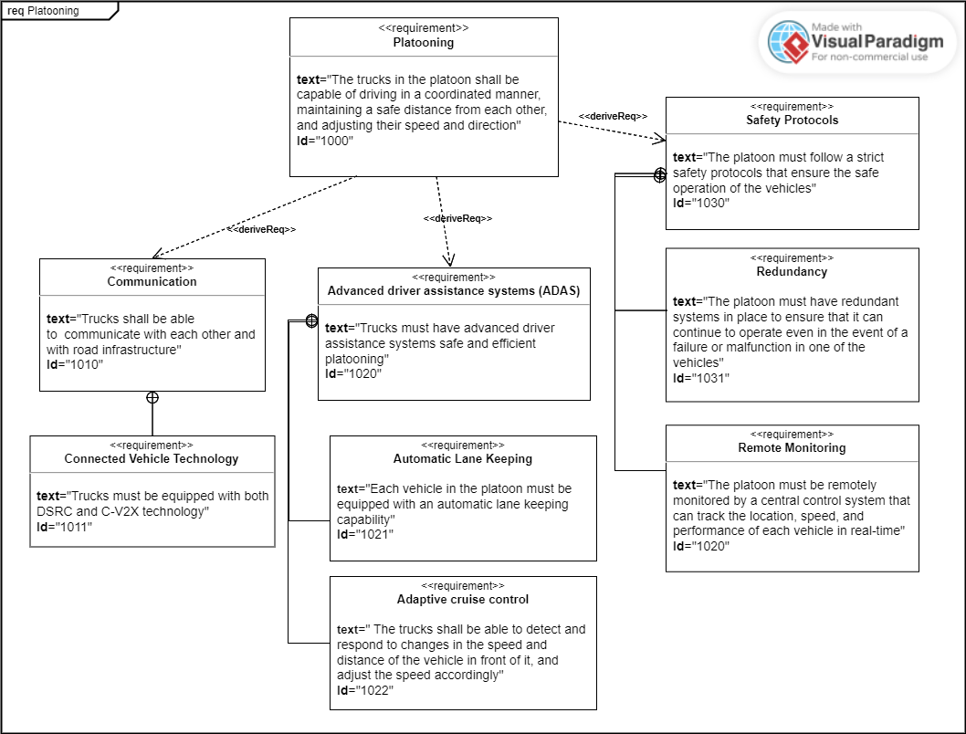
Platooning
Fig: Requirement Diagram

Slide 3
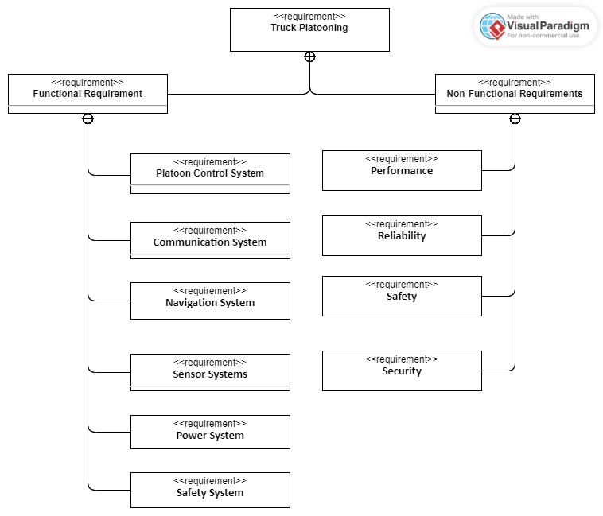
Concept: Requirements

Slide 4
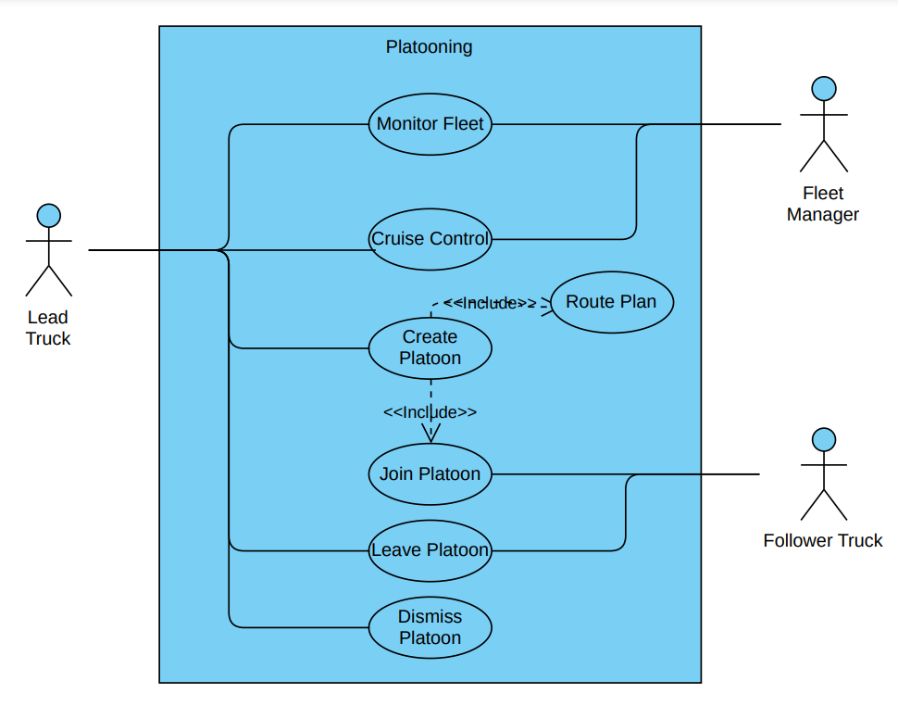
Concept:
Use case

Slide 5
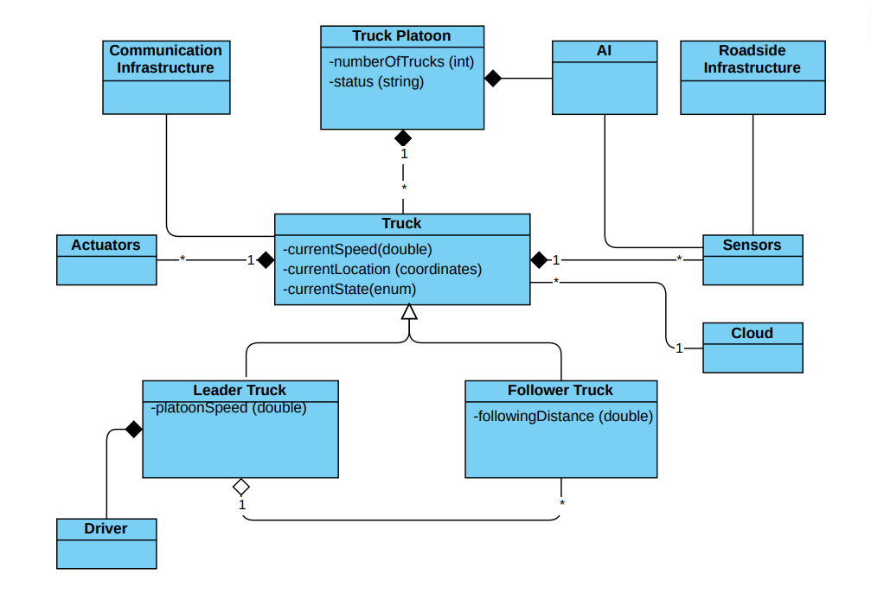
Class diagram

Slide 6
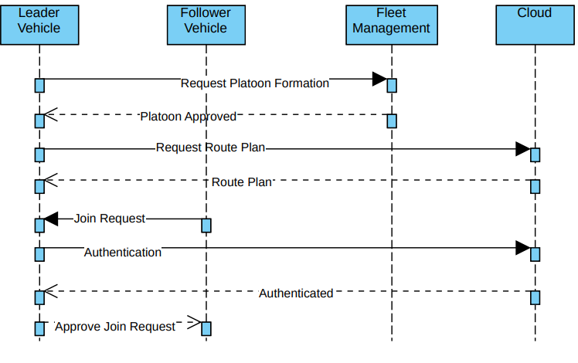
Platoon formation

Slide 7
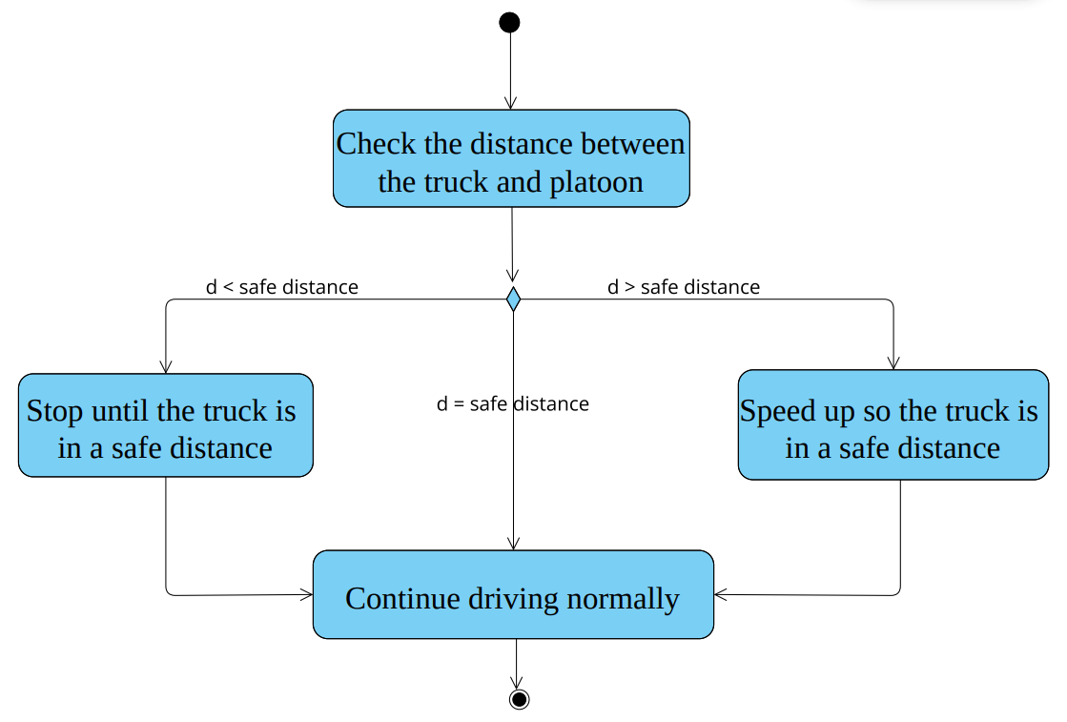
safety

Slide 8
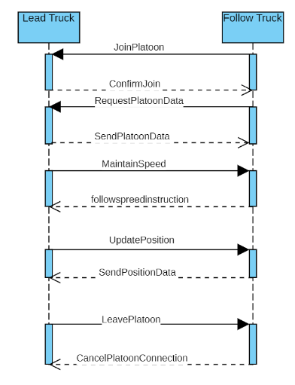
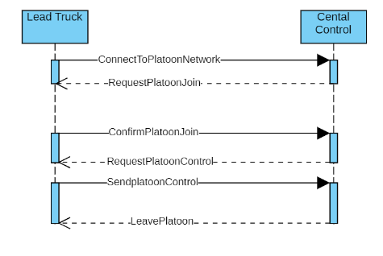
communication
Fig: V2C communication
Fig: V2V communication

Slide 9
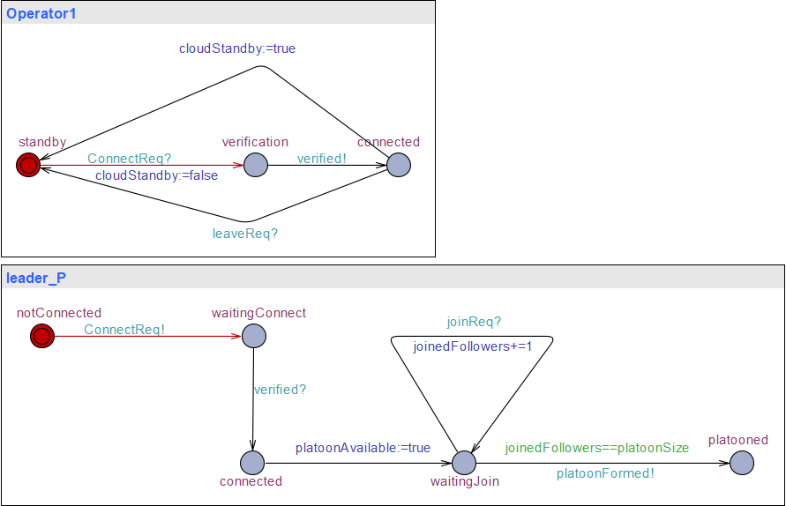
Uppaal: formation

Slide 10
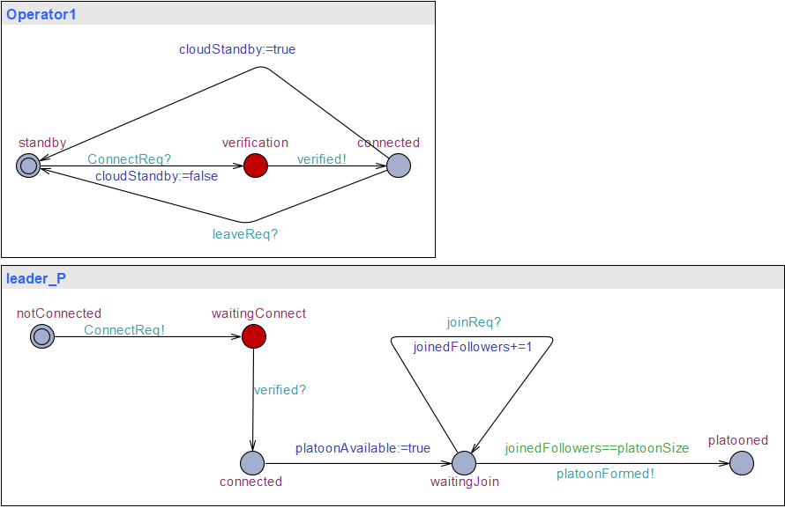
Uppaal: formation

Slide 11
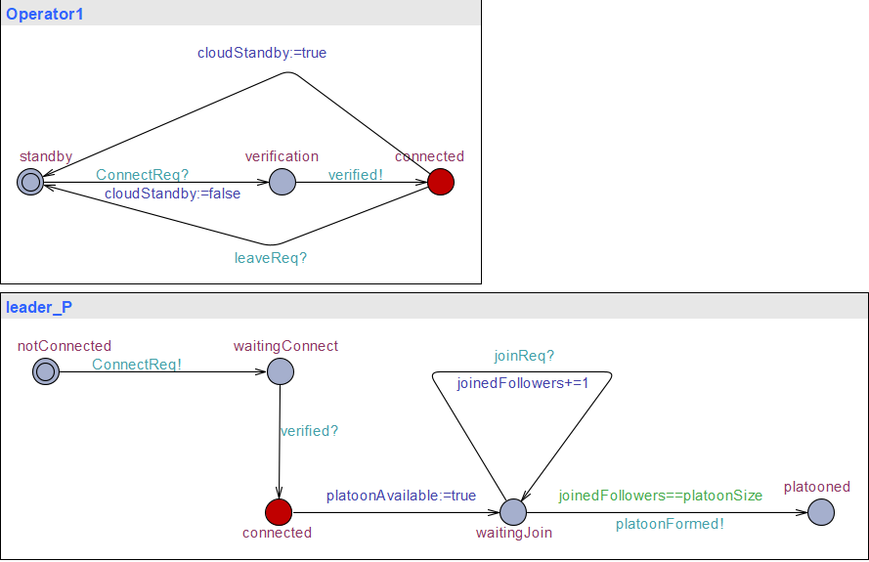
Uppaal: formation

Slide 12
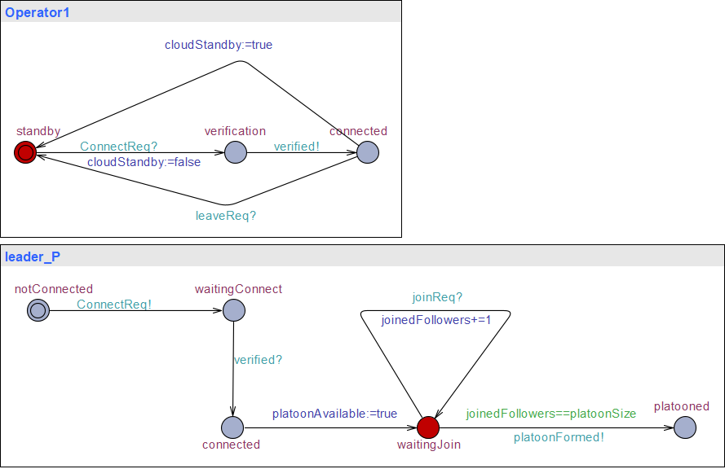
Uppaal: formation

Slide 13
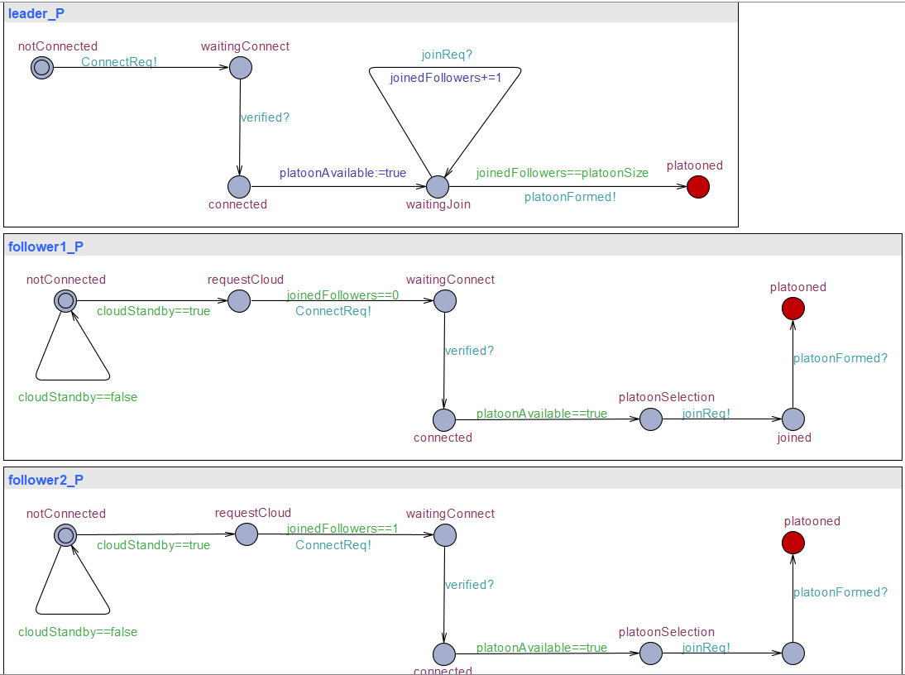
Uppaal: formation

Slide 14
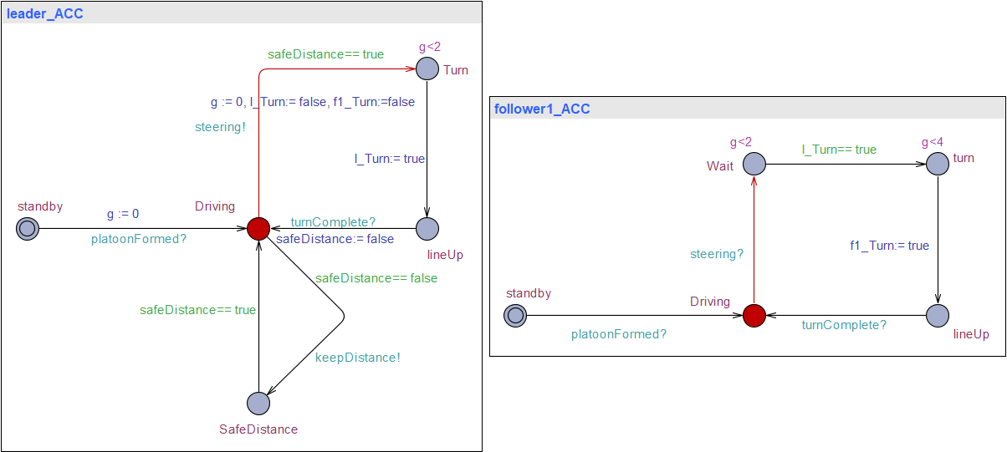
Uppaal: formation

Slide 15
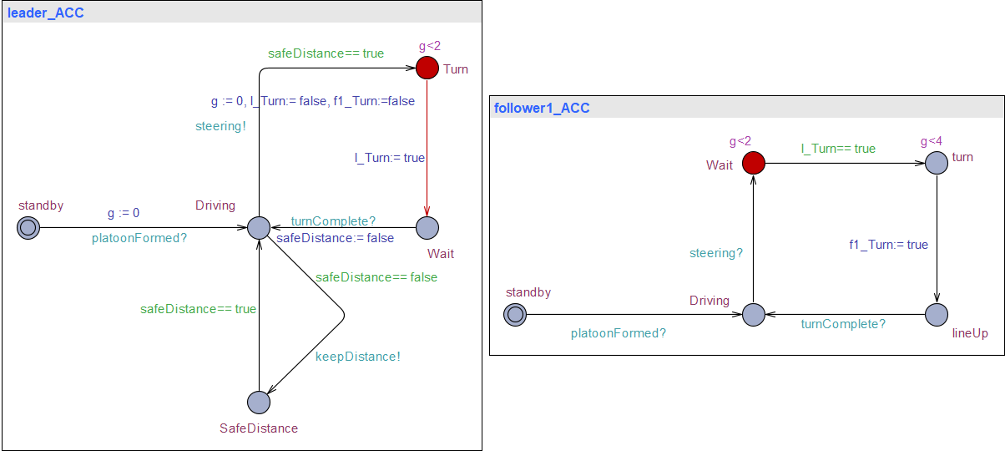
Uppaal: formation

Slide 16
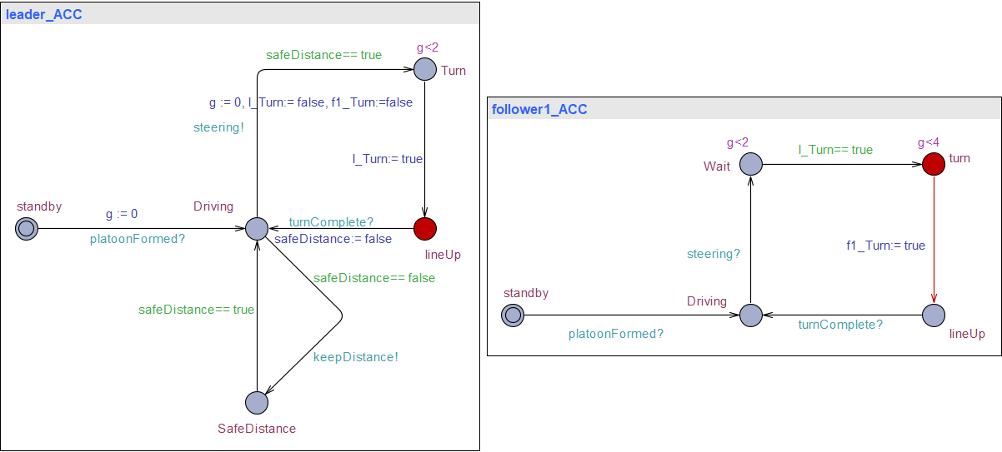
Uppaal: formation

Slide 17
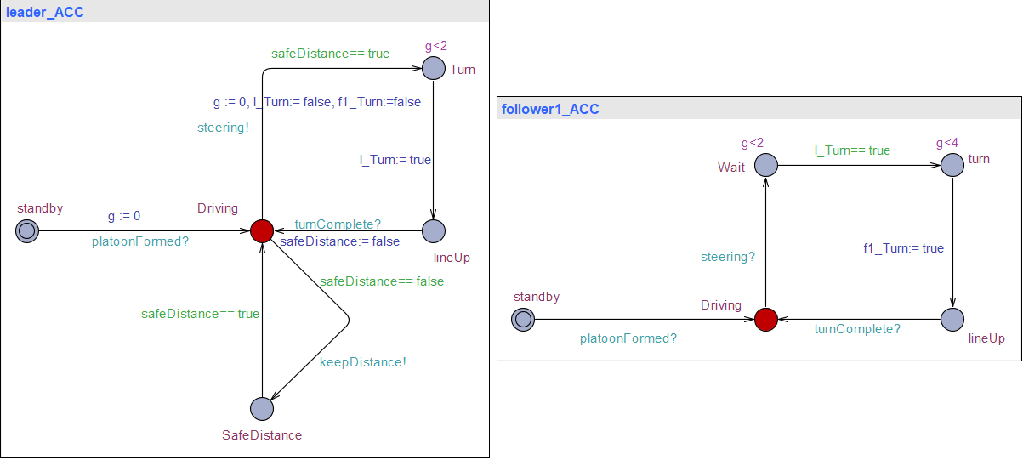
Uppaal: formation

Slide 18
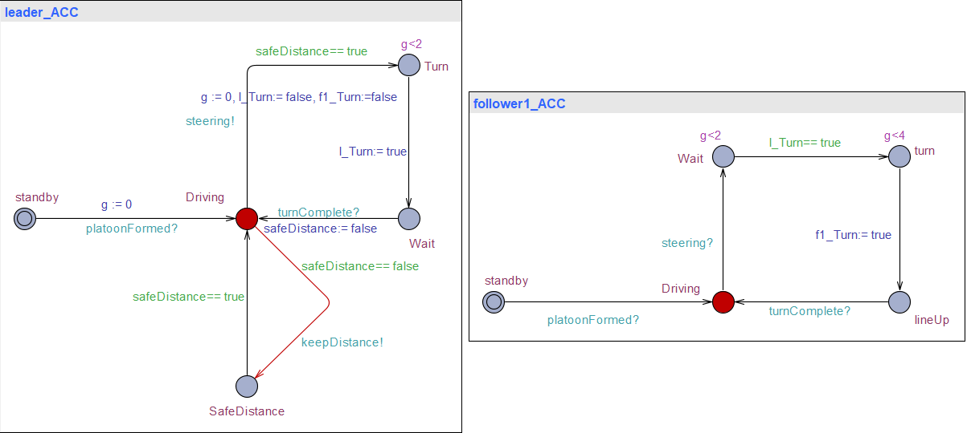
Uppaal: formation

Slide 19
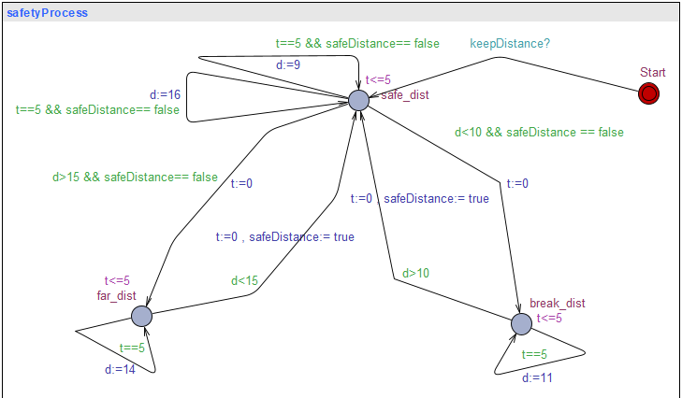
Uppaal: Safety

Slide 20
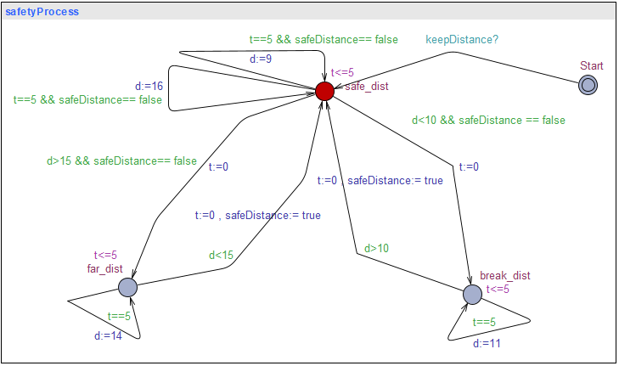
Uppaal: Safety

Slide 21
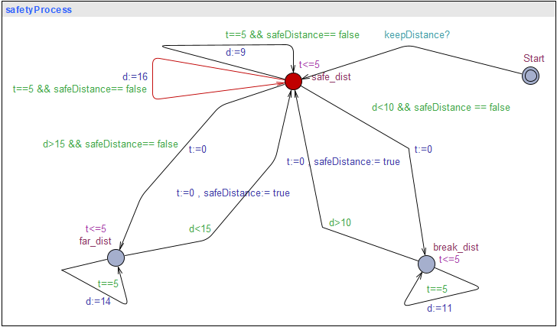
Uppaal: Safety

Slide 22
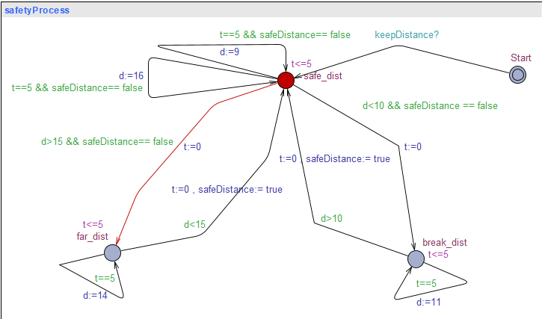
Uppaal: Safety

Slide 23
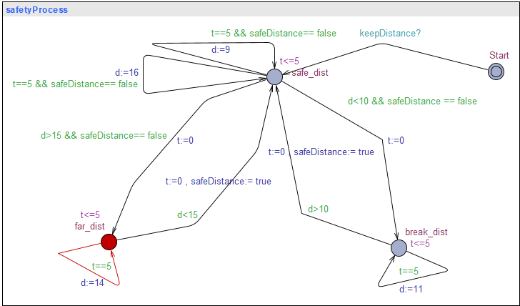
Uppaal: Safety

Slide 24
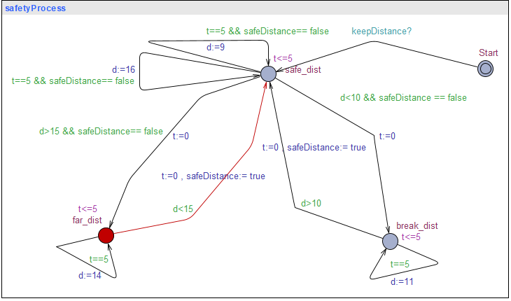
Uppaal: Safety

Slide 25
Uppaal: Safety

Slide 26
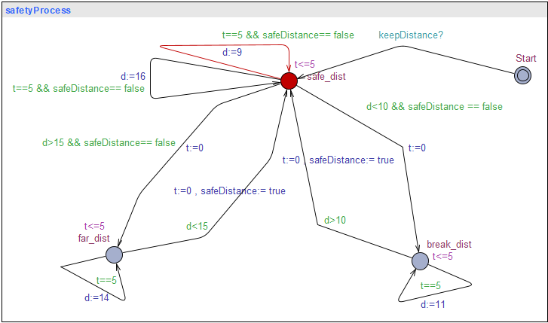
Uppaal: Safety

Slide 27
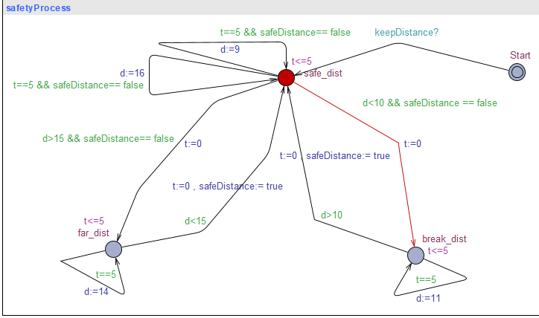
Uppaal: Safety

Slide 28
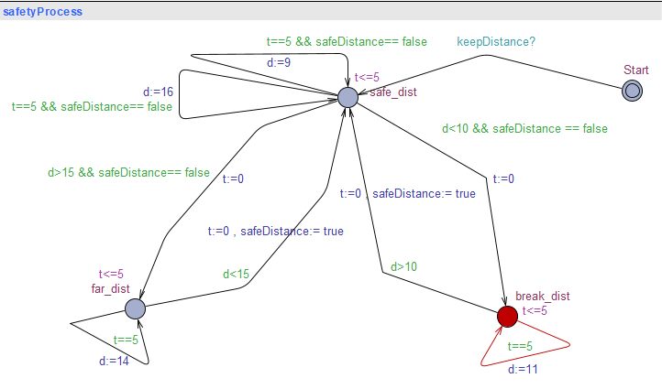
Uppaal: Safety

Slide 29
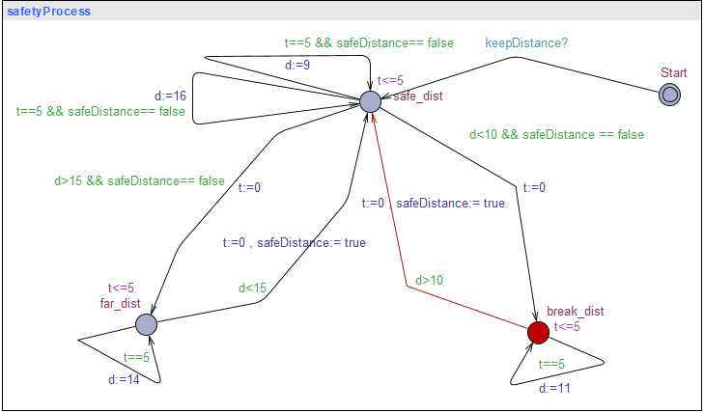
Uppaal: Safety

Slide 30
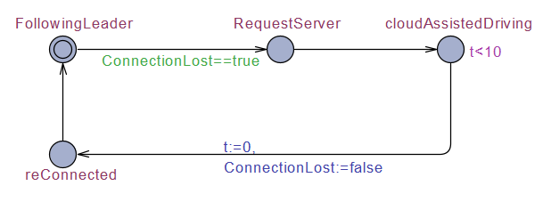
UPPAAL: Connect
Fig: Uppaal Model

Slide 31
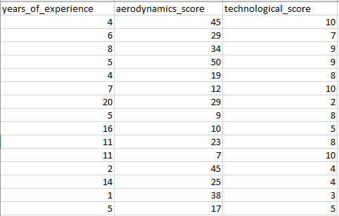
ML: Data preparation
Parameters
years_of_experience = (0, 20)
aerodynamics_score = (5, 50)
technological_score = (1, 10)
5000 samples

Slide 32
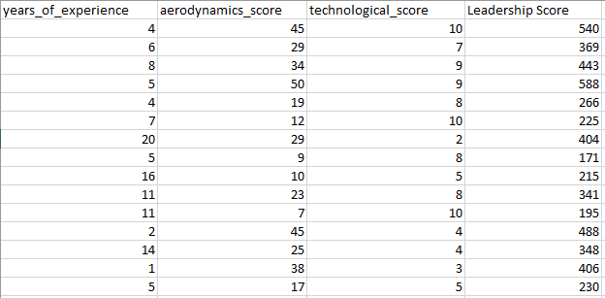
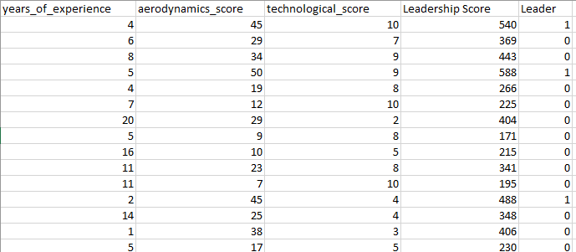

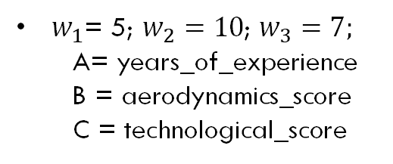
ML: Data preparation
Score $=w_{1}∙A+w_{2}∙B+w_{3}∙C$
How do we label the data?
Where,
$w_{1}$= 5; $w_{2}=10$; $w_{3}=7;$
  A= years_of_experience
B = aerodynamics_score
C = technological_score
If score > 450 :
leader = True

Slide 33
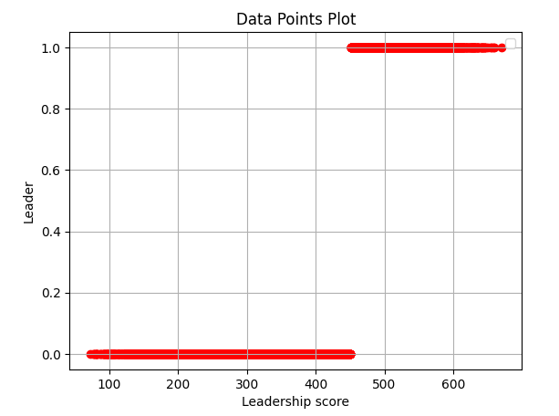
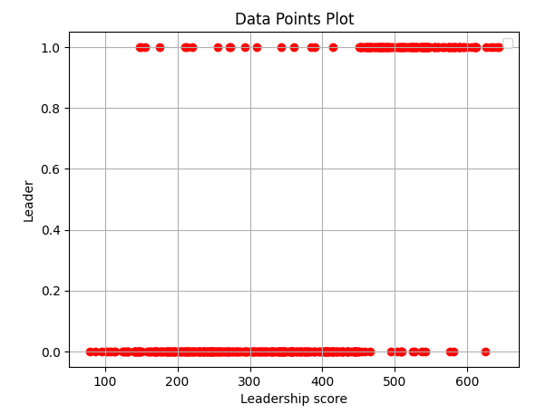
ML: Data preparation
Over Fitting the Model
Added Outliers to avoid overfitting

Slide 34
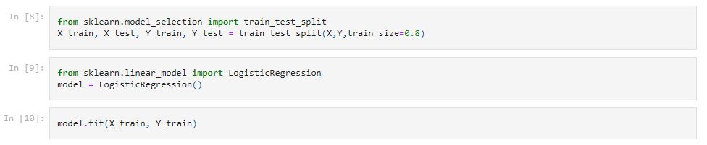
ML:training

Slide 35
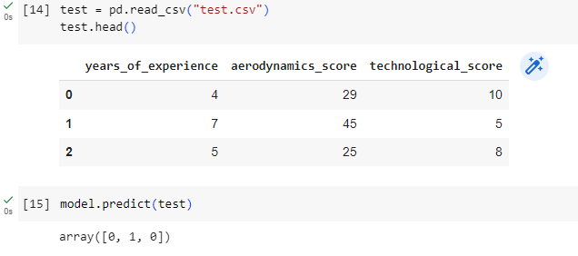
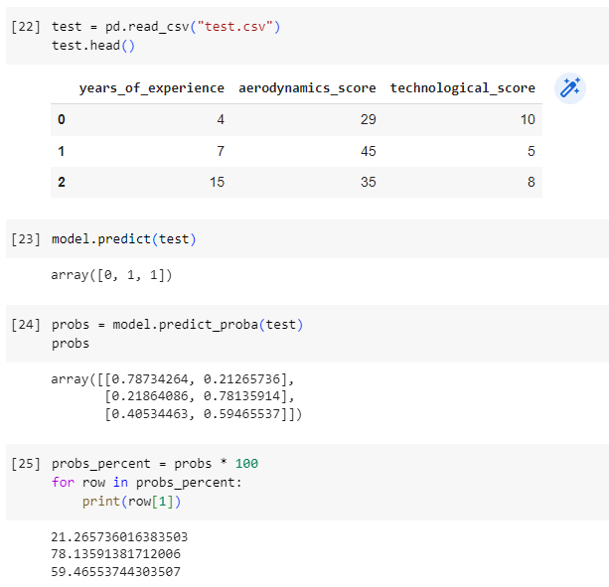
ML: Leader selection

Slide 36
Random Forest Classifier

Slide 37
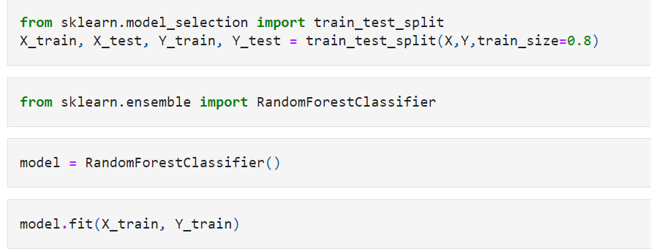
Random forest classifier

Slide 38

comparison
Logistic Regression vs. Random Forest Classifier

Slide 39
Random Forest Classifier
Pros:
Capture non-Linear Relationships (complex patterns in the data)
Cons:
Interpretability (lower compared to linear regression)
Computational Complexity

Slide 40
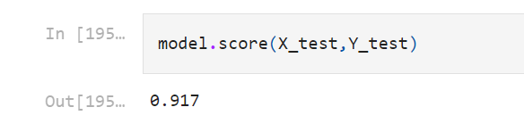
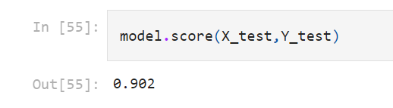
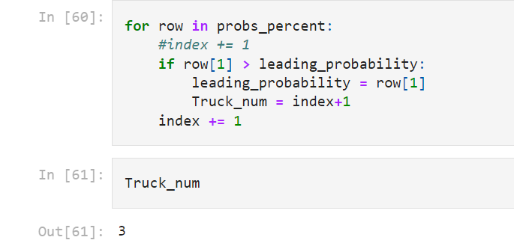
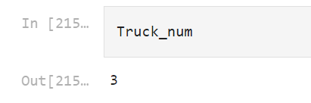
decision
Logistic regression | Random Forest Classifier

Slide 41
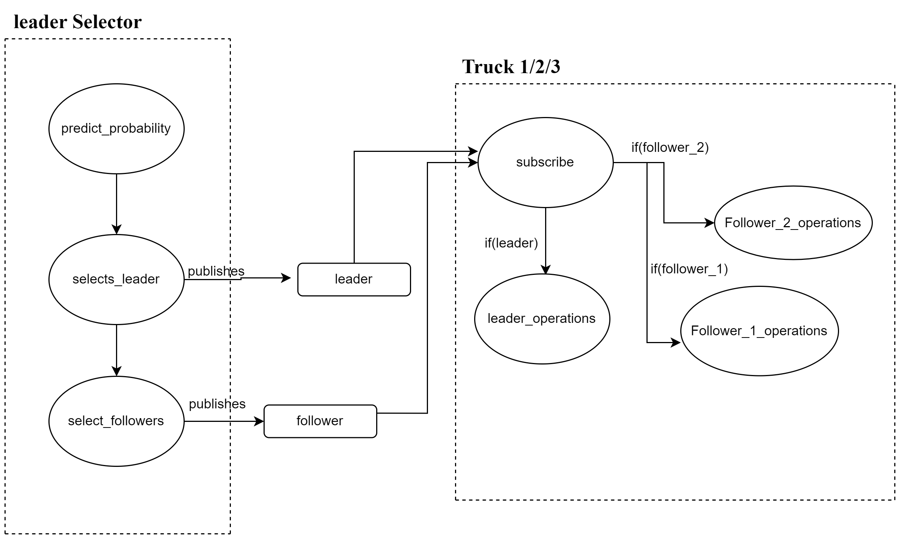
simulation

Slide 42
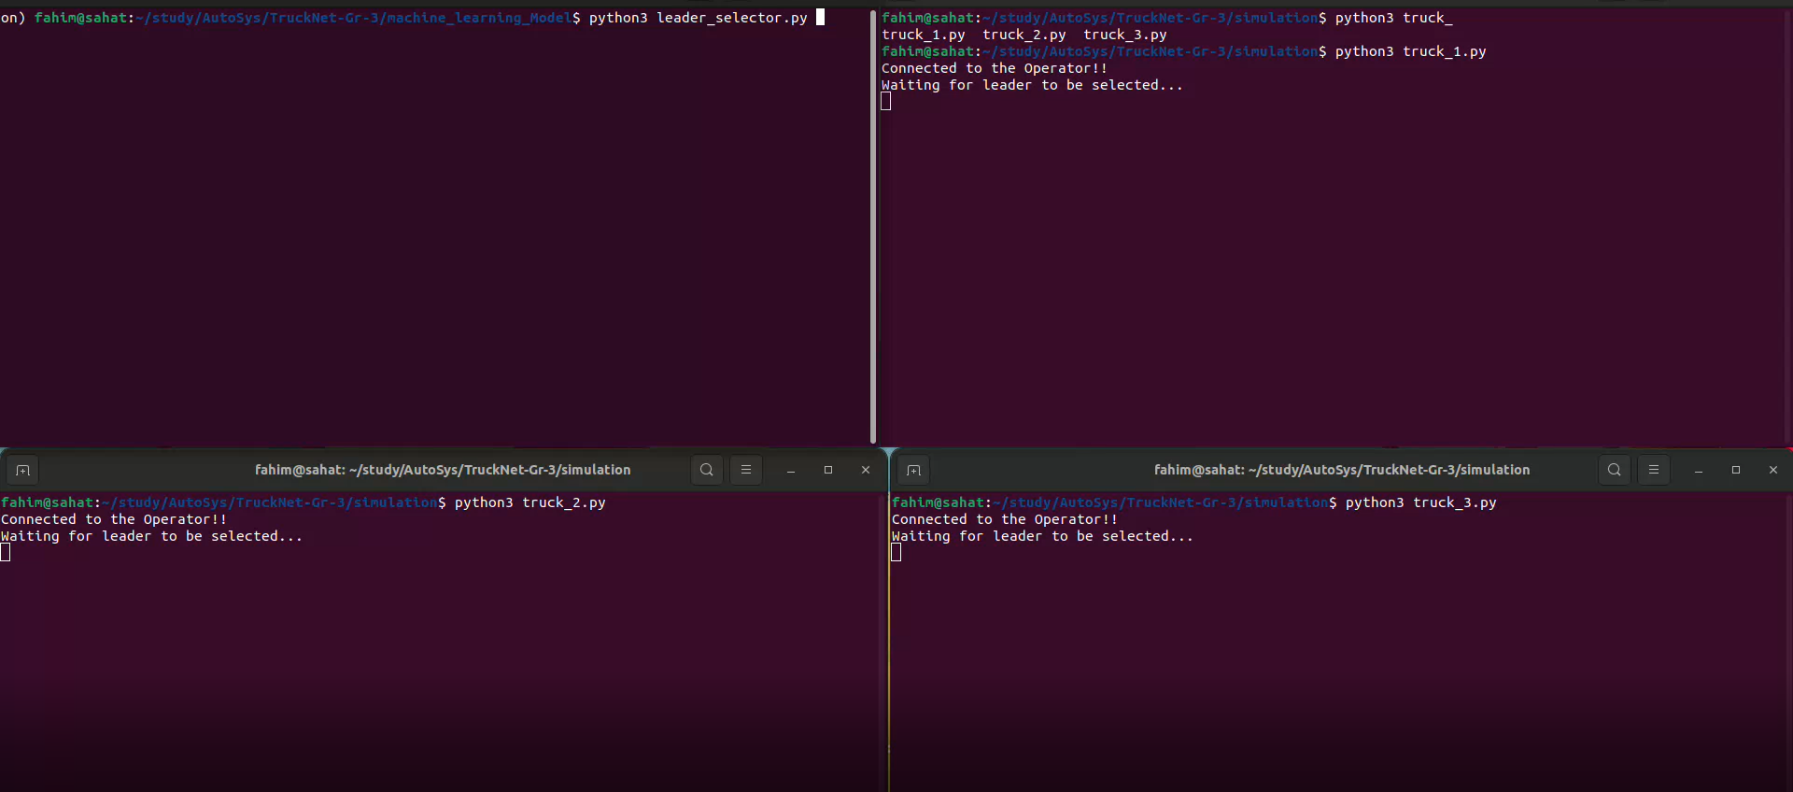
simulation
Leader Selector
Truck 1
Truck 2
Truck 3

Slide 43
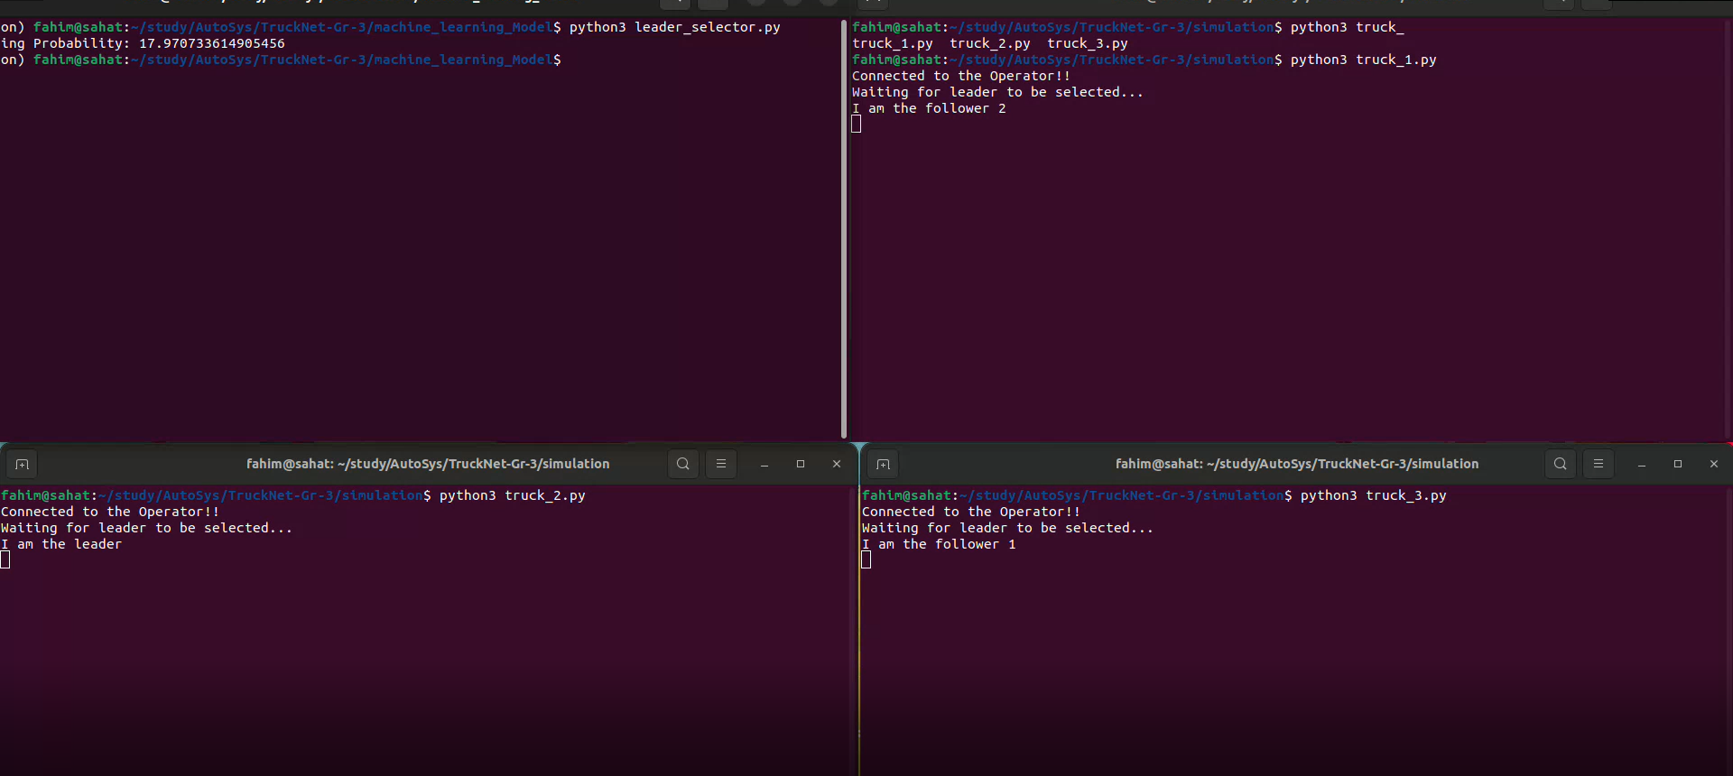
simulation
Truck 1
Truck 2
Truck 3

Slide 44
references

Slide 45
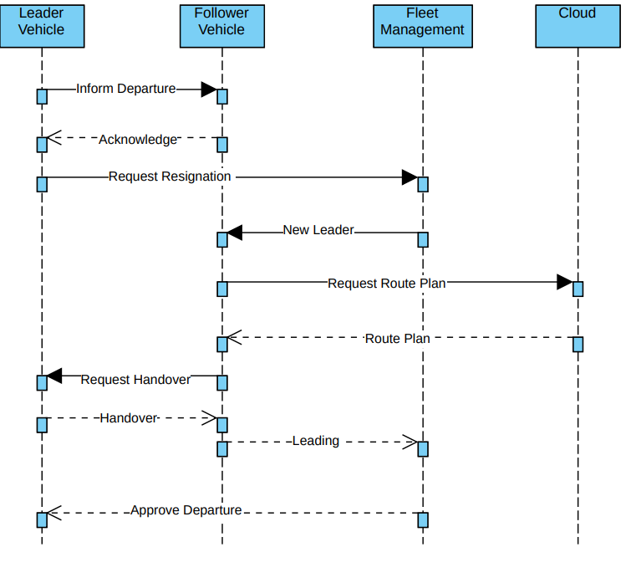
New leader

